Slide 1
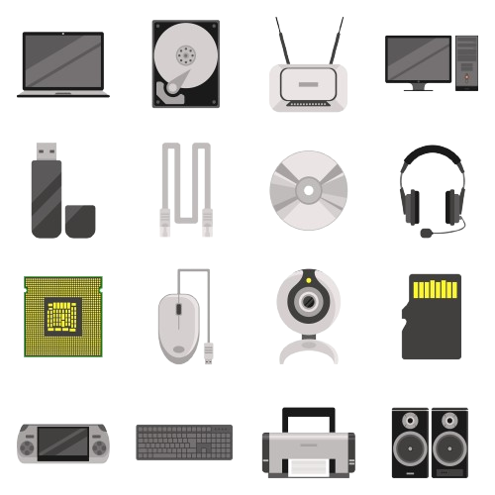

INPUT DEVICES
AN INPUT DEVICE IS DEFINED AS A DEVICE THAT CONVERTS INCOMING DATA AND INSTRUCTIONS INTO A PATTERN OF ELECTRICAL SIGNALS IN BINARY CODE THAT ARE COMPREHENSIBLE TO A DIGITAL COMPUTER.
KEYBOARD, MOUSE, MICROFONE
OUTPUT DEVICES
IT RECEIVES THE BINARY DATA AND DISPLAYS IT IN A WAY THAT THE USER CAN UNDERSTAND, ACCORDING TO THE DEVICE.
MONITOR, PRINTER, SPEAKER
STORAGE DEVICES
IT DOES NOT CONVERT THE DATA, IT ONLY RECEIVES AND STORES IT.
HARD DRIVE, USB DRIVE, MEMORY CARD
COMMUNICATION DEVICES
DATA EXCHANGE
MODEM, NETWORK CARD
BLUETOOTH
THE DISTANCE BETWEEN DEVICES CANNOT BE LARGE (10-100 METERS), THE RANGE IS SHORT (100 > 200 MS), AND POWER CONSUMPTION IS LOW.
COMMUNICATION IS DONE VIA LOW-POWER RADIO WAVES.
WIRED CONNECTION
FASTEST WAY TO SEND DATA. THE DEVICE SENDS DATA VIA ELECTRICAL SIGNALS. IT HAS THE LOWEST LATENCY, HOWEVER, THE RANGE IS LIMITED BY THE CABLE. (5 A 10 MS)
USB, HDMI, ETHERNET, VGA, DISPLAYPORT
WIRELESS - WI-FI
THE DEVICE CONVERTS THE DATA INTO A RADIO SIGNAL, AS WI-FI USES RADIO FREQUENCIES. (16.06MS)
THIS CAN INTRODUCE HIGHER LATENCY THAN IF THE DEVICE WERE CONNECTED BY CABLE, BUT NOWADAYS IT IS PRACTICALLY IMPERCEPTIBLE.

